Slide 1
Sequential Circuit

Slide 2
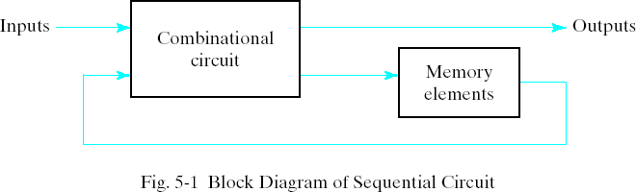
Sequential Circuits Synchronous Sequential Logic
Every digital system is likely to have combinational circuits, most systems encountered in practice also include storage elements, which require that the system be described in term of sequential logic.

Slide 3
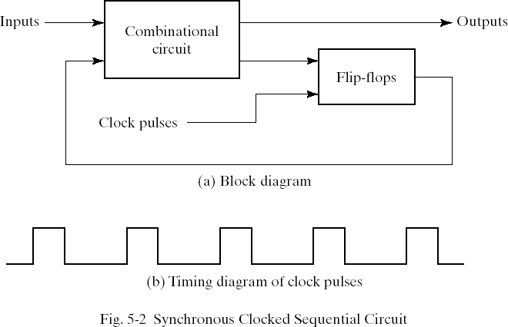
Synchronous Clocked Sequential Circuit
A sequential circuit may use many flip-flops to store as many bits as necessary. The outputs can come either from the combinational circuit or from the flip-flops or both.

Slide 4
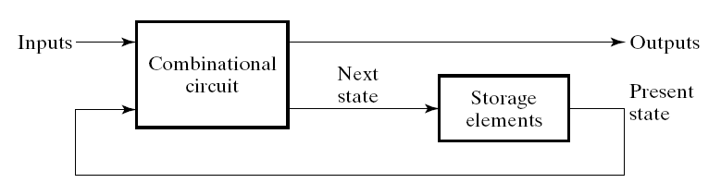
Introduction to Sequential Circuits
(State)
(State)
Combinatorial Logic
Next state function Next State = f(Inputs, State)
2 output function types : Mealy & Moore
Output function: Mealy Circuits Outputs = g(Inputs, State)
Output function: Moore Circuits Outputs = h(State)
Output function type depends on specification and affects the design significantly

Slide 5
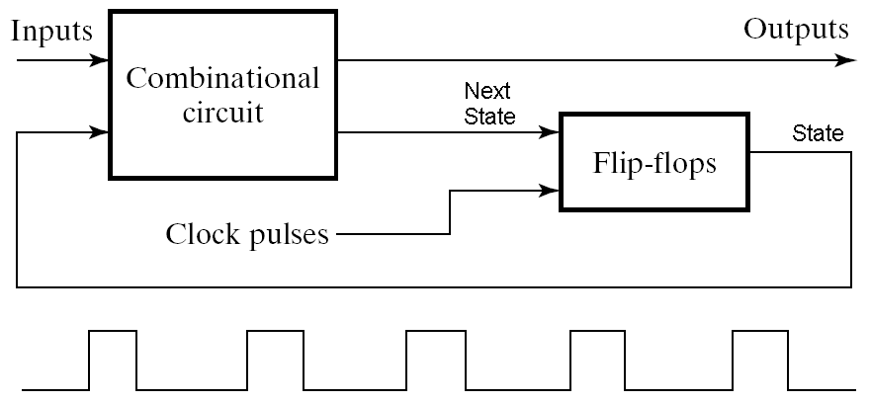
Timing of Sequential Circuits Two Approaches
Behavior depends on the times at which storage elements ‘see’ their inputs and change their outputs (next state → present state)
Asynchronous
Behavior defined from knowledge of inputs at any instant of time and the order in continuous time in which inputs change
Synchronous
Behavior defined from knowledge of signals at discrete instances of time
Storage elements see their inputs and change state only in relation to a timing signal (clock pulses from a clock)
The synchronous abstraction allows handling complex designs!
Storage Elements

Slide 6
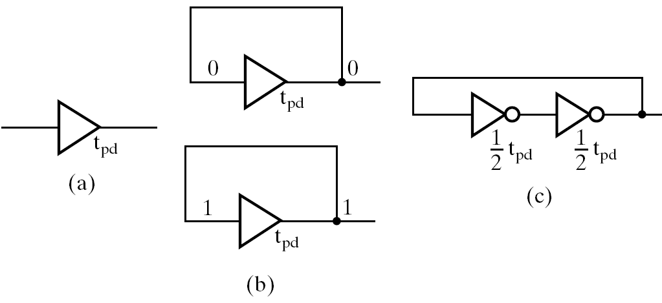
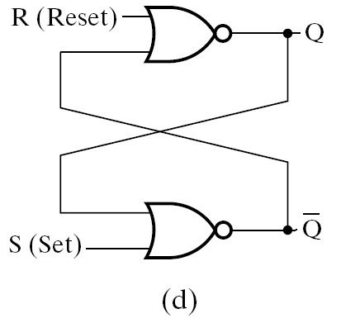
Data Storage Logic Structures
t_{pd}
Data In (Change data stored)
Output-Supporting
feedback
Delay in
A non-inverting
Buffer
Problem:
Data stored only
for short time, i.e.
Propagation delay t_{pd}
Feedback across
Two inverting buffers
Connected in series
Non-inverting buffer
With feedback- indefinite
Set-Reset
NOR Latch
Separate inputs for
Data in and for
feedback
Problem: No separate input for data.
Difficult to change data stored

Slide 7
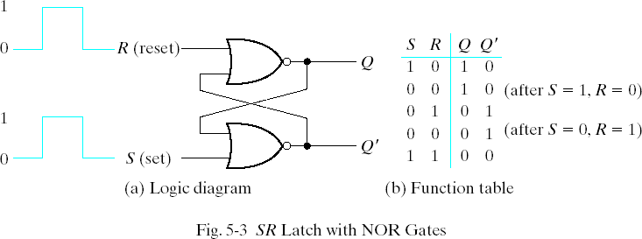
5-2 Latches SR Latch
The SR latch is a circuit with two cross-coupled NOR gates or two cross-coupled NAND gates. It has two inputs labeled S for set and R for reset.

Slide 8
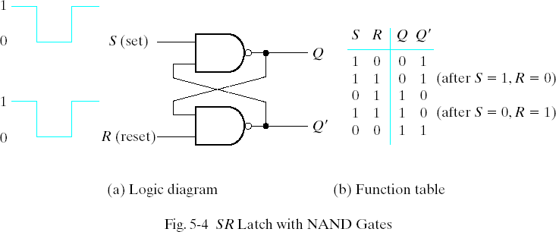
SR Latch with NAND Gates

Slide 9
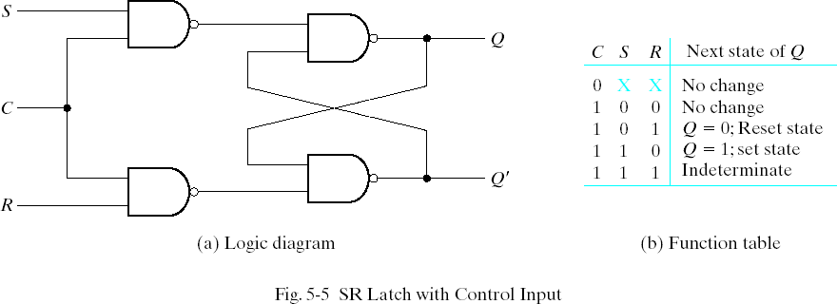
SR Latch with Control Input
The operation of the basic SR latch can be modified by providing an additional control input that determines when the state of the latch can be changed. In Fig. 5-5, it consists of the basic SR latch and two additional NAND gates.

Slide 10
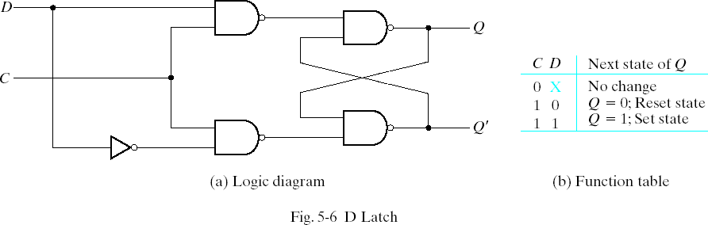
D Latch
One way to eliminate the undesirable condition of the indeterminate state in SR latch is to ensure that inputs S and R are never equal to 1 at the same time in Fig 5-5. This is done in the D latch.

Slide 11
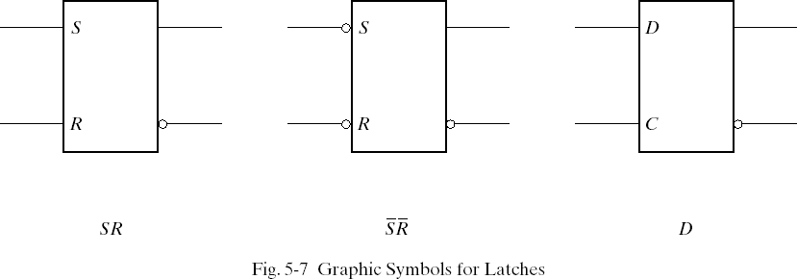
Graphic Symbols for latches
A latch is designated by a rectangular block with inputs on the left and outputs on the right. One output designates the normal output, and the other designates the complement output.

Slide 12
5-3 Flip-Flops
The state of a latch or flip-flop is switched by a change in the control input. This momentary change is called a trigger and the transition it cause is said to trigger the flip-flop. The D latch with pulses in its control input is essentially a flip-flop
that is triggered every time the pulse goes to the logic 1 level. As long as the pulse input remains in the level, any changes in the data input will change the output and the state of the latch.

Slide 13
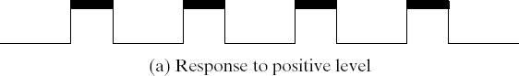
Clock Response in Latch
In Fig (a) a positive level response in the control input allows changes, in the output when the D input changes while the clock pulse stays at logic 1.

Slide 14
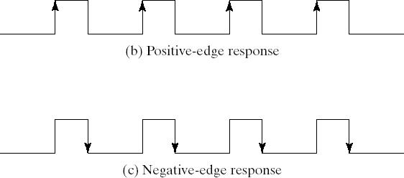
Clock Response in Flip-Flop

Slide 15
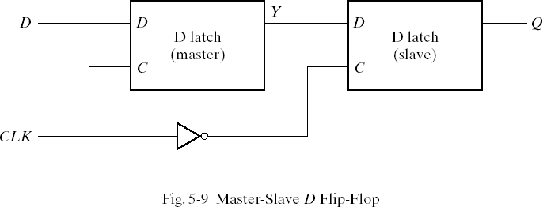
Edge-Triggered D Flip-Flop
The first latch is called the master and the second the slave. The circuit samples the D input and changes its output Q only at the negative-edge of the controlling clock.
D 1 1 0 0 1 1 …
Y 1 1 0 0 1 1 …
Q ? 1 1 0 0 1 ….
CLK

Slide 16
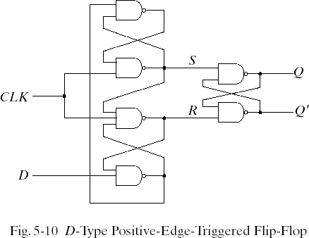
D-Type Positive-Edge-Triggered Flip-Flop
Another more efficient construction of an edge-triggered D flip-flop uses three SR latches. Two latches respond to the external D(data) and CLK(clock) inputs. The third latch provides the outputs for the flip-flop.
Ref. p.175 texts

Slide 17
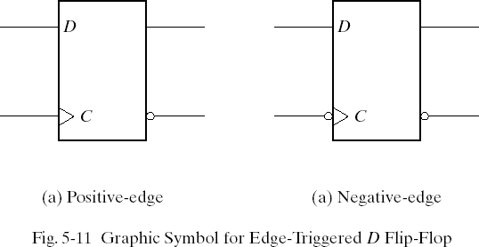
Graphic Symbol for Edge-Triggered D Flip-Flop

Slide 18
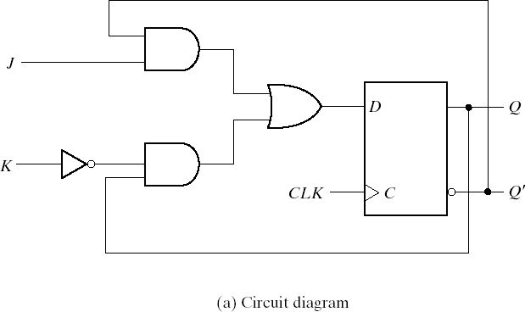
Other Flip-Flops JK Flip-Flop
There are three operations that can be performed with a flip-flop: set it to 1, reset it to 0, or complement its output. The JK flip-flop performs all three operations. The circuit diagram of a JK flip-flop constructed with a D flip-flop and gates.

Slide 19
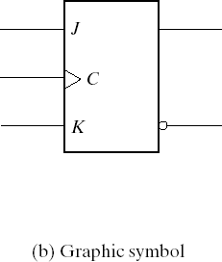
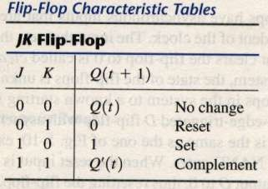
JK Flip-Flop
The J input sets the flip-flop to 1, the K input resets it to 0, and when both inputs are enabled, the output is complemented. This can be verified by investigating the circuit applied to the D input:
D = J Q` + K` Q

Slide 20
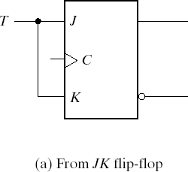
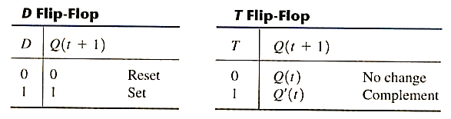
T Flip-Flop
The T(toggle) flip-flop is a complementing flip-flop and can be obtained from a JK flip-flop when inputs J and K are tied together.

Slide 21
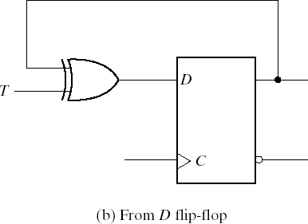
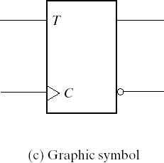
T Flip-Flop
The T flip-flop can be constructed with a D flip-flop and an exclusive-OR gates as shown in Fig. (b). The expression for the D input is
D = T Q = TQ` + T`Q

Slide 22
Characteristic Equations
D flip-flop Characteristic Equations
Q(t + 1) = D
JK flip-flop Characteristic Equations
Q(t + 1) = JQ` + K`Q
T flip-flop Characteristic Equations
Q(t + 1) = T Q = TQ` + T`Q

Slide 23
Direct Inputs
Some flip-flops have asynchronous inputs that are used to force the flip-flop to a particular state independent of the clock. The input that sets the flip-flop to 1 is called present or direct set. The input that clears the flip-flop to 0 is called clear or direct reset. When power is turned on a digital system, the state of the flip-flops is unknown. The direct inputs are useful for bringing all flip-flops in the system to a known starting state prior to the clocked operation.

Slide 24
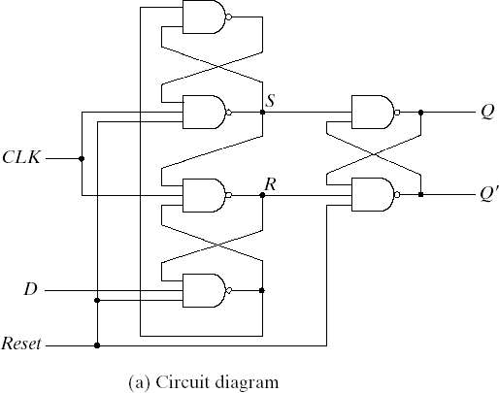
D Flip-Flop with Asynchronous Reset
A positive-edge-triggered D flip-flop with asynchronous reset
is shown in Fig(a).

Slide 25
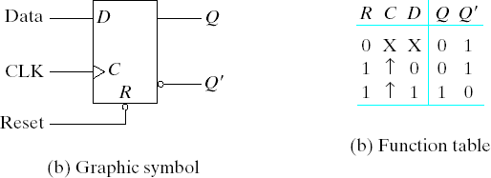
D Flip-Flop with Asynchronous Reset

Slide 26
5-4 Analysis of Clocked Sequential Circuits
The analysis of a sequential circuit consists of obtaining a table or a diagram for the time sequence of inputs, outputs, and internal states. It is also possible to write Boolean expressions that describe the behavior of the sequential circuit. These expressions must include the necessary time sequence, either directly or indirectly.

Slide 27
State Equations
The behavior of a clocked sequential circuit can be described algebraically by means of state equations. A state equation specifies the next state as a function of the present state and inputs. Consider the sequential circuit shown in Fig. 5-15. It consists of two D flip-flops A and B, an input x and an output y.

Slide 28
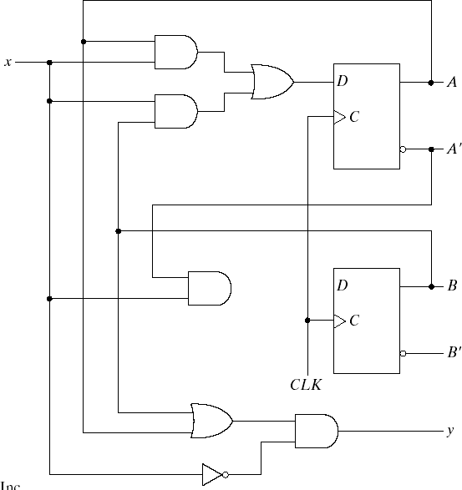
Fig.5-15 Example of Sequential Circuit

Slide 29
State Equation
A(t+1) = A(t) x(t) + B(t) x(t)
B(t+1) = A`(t) x(t)
A state equation is an algebraic expression that specifies the condition for a flip-flop state transition. The left side of the equation with (t+1) denotes the next state of the flip- flop one clock edge later. The right side of the equation is Boolean expression that specifies the present state and input conditions that make the next state equal to 1.
Y(t) = (A(t) + B(t)) x(t)`

Slide 30
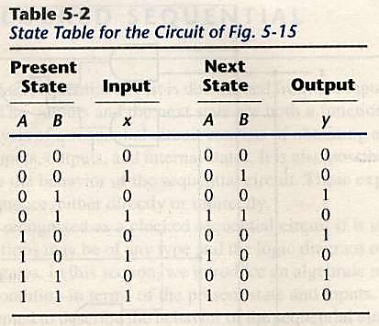
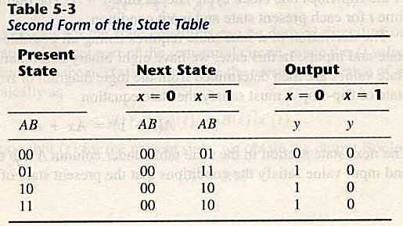
State Table
The time sequence of inputs, outputs, and flip-flop states can be enumerated in a state table (sometimes called transition table).

Slide 31
Applications of Flip-Flops:
These are the various types of flip-flops being used in digital electronic circuits and the applications of Flip-flops are as specified below.
Counters
Frequency Dividers
Shift Registers
Storage Registers
Bounce elimination switch
Data storage
Data transfer
Latch
Registers
Memory

Slide 32
Counters in Digital Logic
A Counter is a device which stores (and sometimes displays) the number of times a particular event or process has occurred, often in relationship to a clock signal. Counters are used in digital electronics for counting purpose, they can count specific event happening in the circuit.
Counters are broadly divided into two categories
Asynchronous counter
Synchronous counter

Slide 33
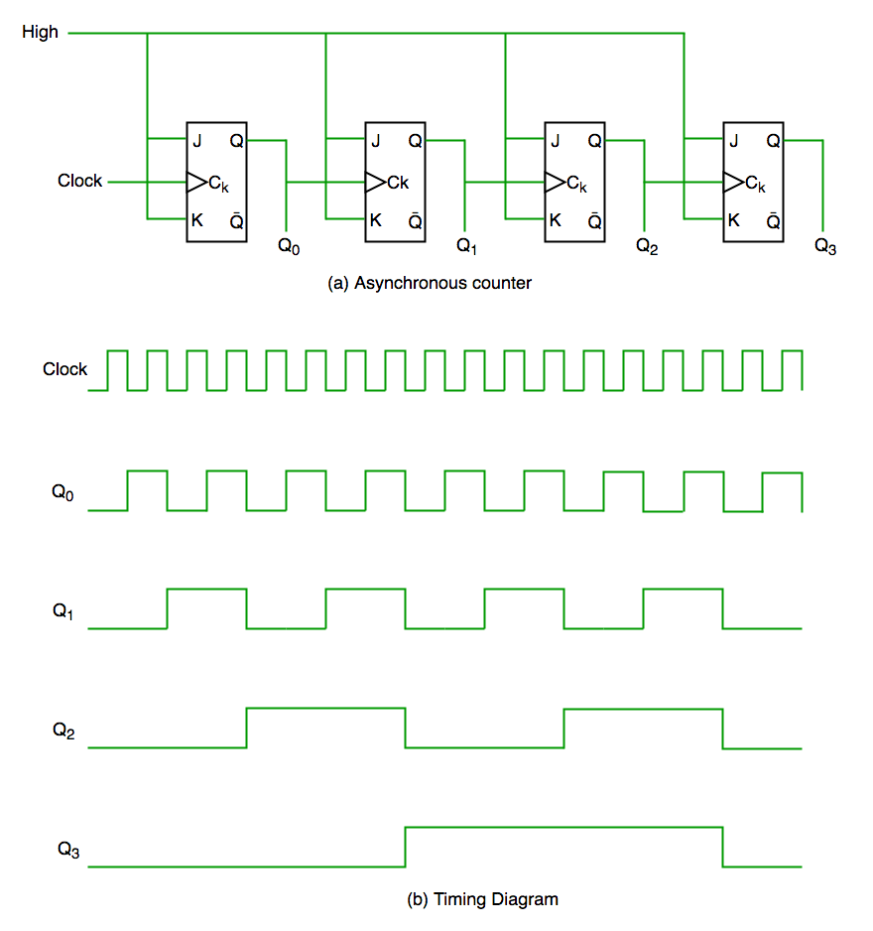
Asynchronous Counter
In asynchronous counter we don’t use universal clock, only first flip flop is driven by main clock and the clock input of rest of the following flip flop is driven by output of previous flip flops. We can understand it by following diagram-

Slide 34
Asynchronous Counter
Ripples are generated through Q0,Q1,Q2,Q3 hence it is also called RIPPLE counter and serial counter. A ripple counter is a cascaded arrangement of flip flops where the output of one flip flop drives the clock input of the following flip flop

Slide 35
Synchronous Counter
Synchronous counter has one global clock which drives each flip flop so output changes in parallel. The one advantage of synchronous counter over asynchronous counter is, it can operate on higher frequency than asynchronous counter as it does not have cumulative delay because of same clock is given to each flip flop. It is also called as parallel counter.

Slide 36
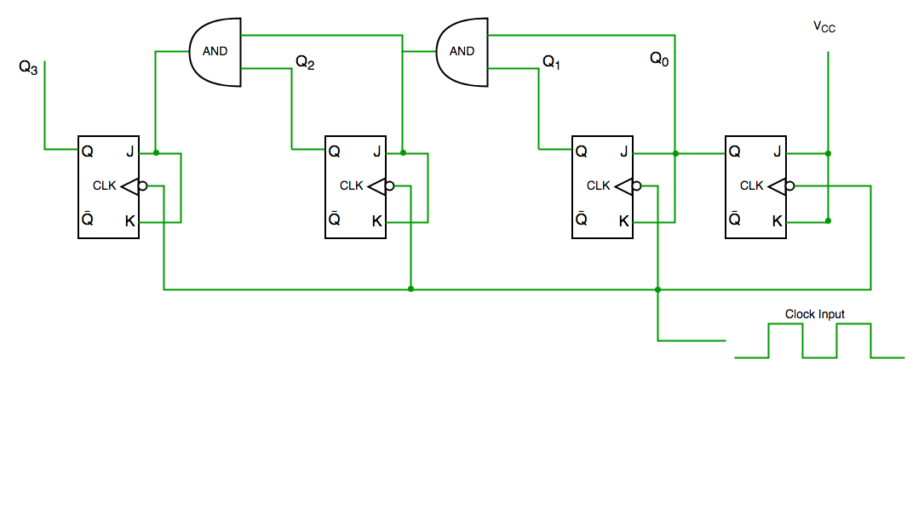
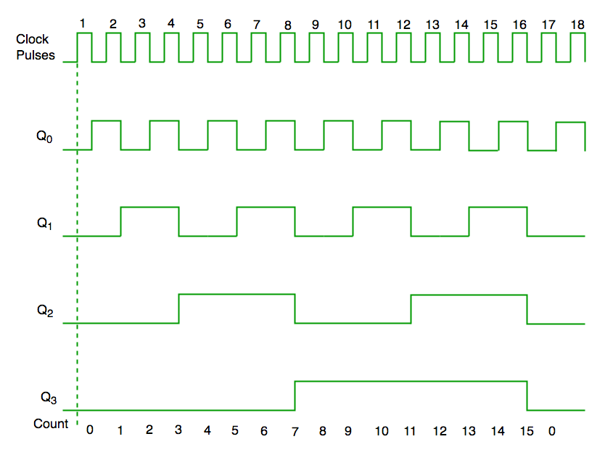

Slide 37
Decade Counter
Clock pulse | Q3 | Q2 | Q1 | Q0
0 | 0 | 0 | 0 | 0
1 | 0 | 0 | 0 | 1
2 | 0 | 0 | 1 | 0
3 | 0 | 0 | 1 | 1
4 | 0 | 1 | 0 | 0
5 | 0 | 1 | 0 | 1
6 | 0 | 1 | 1 | 0
7 | 0 | 1 | 1 | 1
8 | 1 | 0 | 0 | 0
9 | 1 | 0 | 0 | 1
10 | 0 | 0 | 0 | 0
A decade counter counts ten different states and then reset to its initial states. A simple decade counter will count from 0 to 9 but we can also make the decade counters which can go through any ten states between 0 to 15(for 4 bit counter).

Slide 38
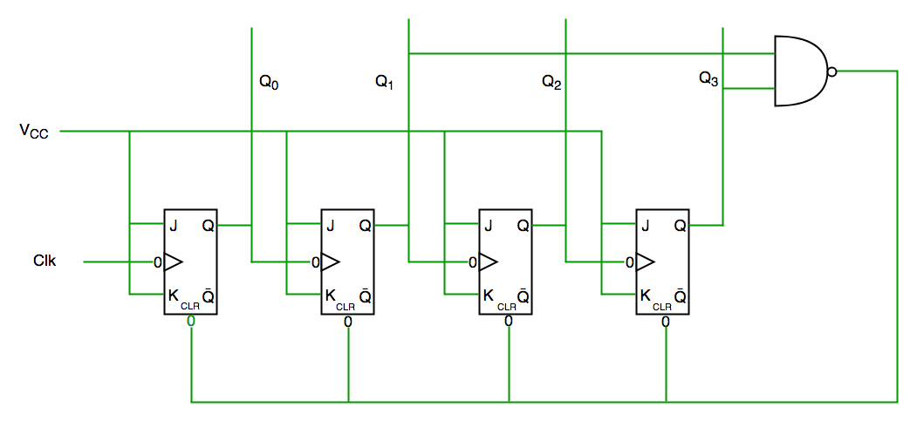
Decade counter

Slide 39
Ring Counter in Digital Logic
A ring counter is a typical application of the Shift register. The ring counter is almost the same as the shift counter. The only change is that the output of the last flip-flop is connected to the input of the first flip-flop in the case of the ring counter but in the case of the shift register it is taken as output.

Slide 40
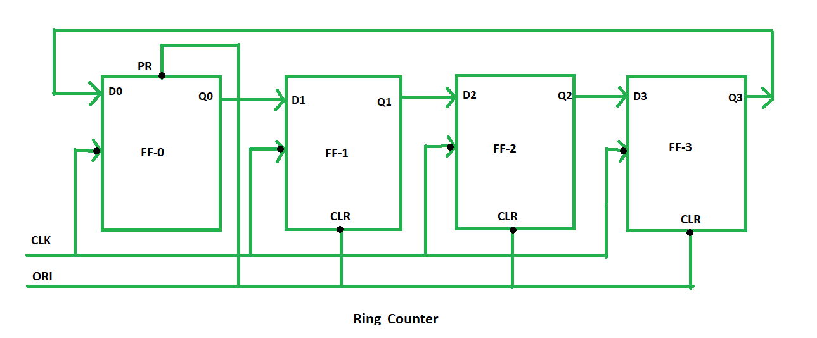
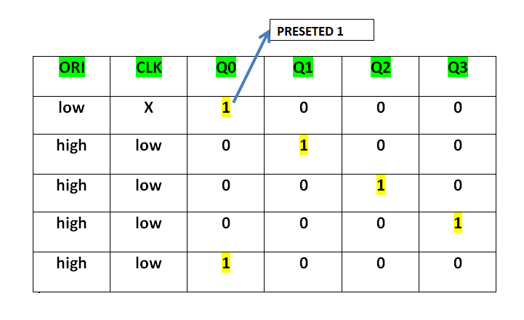
Ring Counter

